Slide 2
Teacher overview
TEACHERS’ NOTES
Overview
The UEFA Women’s EURO 2022 Schools Programme is designed to inspire and excite pupils in the run-up to the tournament. UEFA Women’s EURO 2022 will release school resources for pupils aged 7 to 14, across three main themes: Learn, Play, Support. A range of resources have already been released and you can access the resources here: WEURO2022Schools.com
Age group
7-14 years
Schools Week
UEFA Women’s EURO 2022 Schools Week will run from the 11-15th July. During Schools Week, teachers can use a variety of the resources to build excitement and to bring young people together to celebrate the players, teams and countries of the tournament.
We propose an optional format for your Schools Week in this PowerPoint. This PowerPoint is designed to be used flexibly; you can choose as many or as few ideas as you like.
In the run-up to Schools Week, use this PowerPoint to introduce the week and explain what’s to come. This presentation can be used as an assembly or as an in-class introduction to Schools Week.
All schools across the country will be getting involved with Schools Week. Share your Schools Week activity using #WEURO2022.
Resources and preparation
If following the optional format proposed for your Schools Week, each slide will explain any resources needed. You can also use the optional Schools Week timetable to help plan your week.
Notes:
Teacher overview
You can run your Schools Week in a different week in the run-up to or during the tournament, if this date doesn’t work.
To download these resources, sign or register at WEURO2022Schools.com and don’t forget to share your Schools Week activity using #WEURO2022.

Slide 3
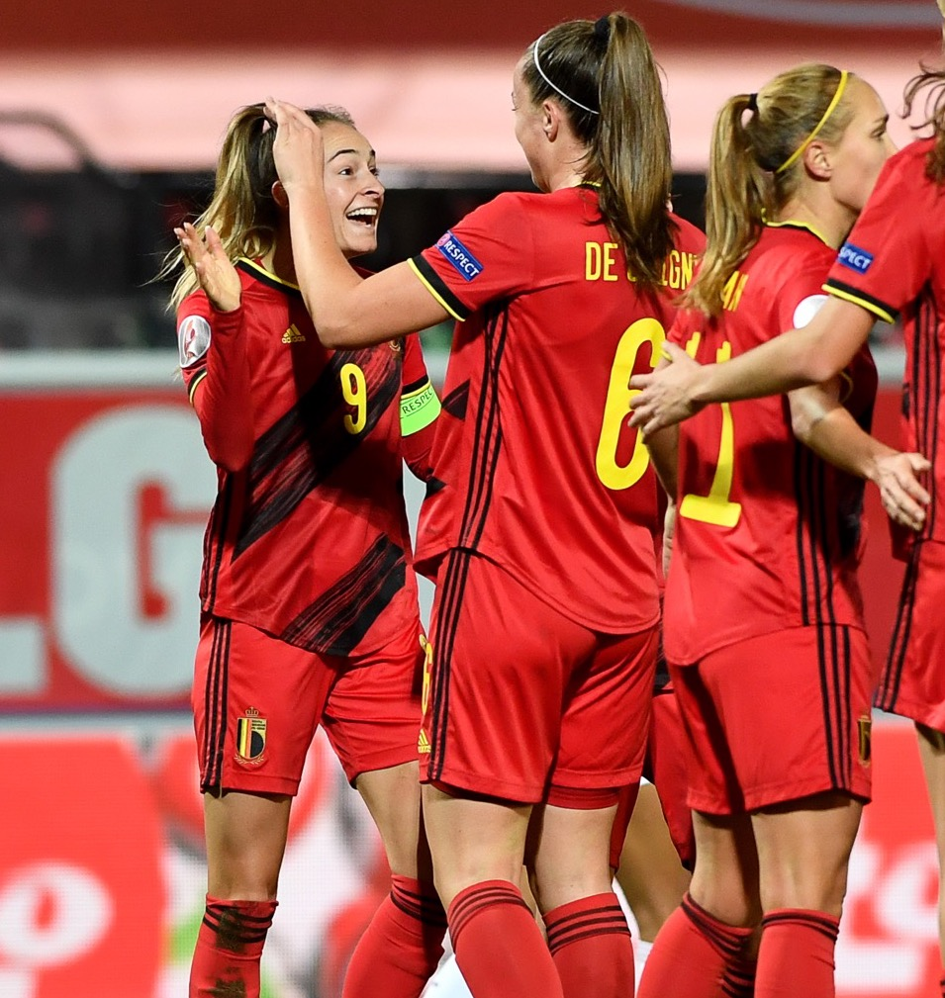
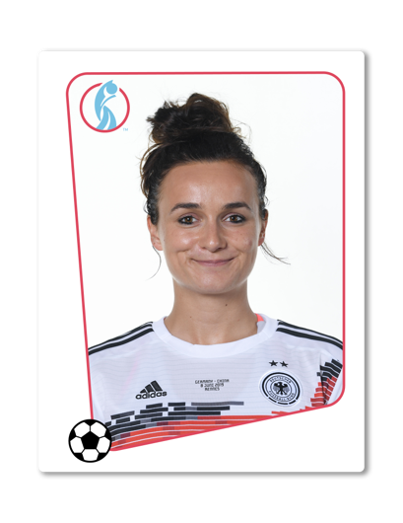

What is UEFA Women’s EURO?
UEFA Women’s EURO is a large football tournament between other national teams that are part of UEFA (the organisation responsible for managing European Football).
It is held every four years and this year the tournament will be hosted by England!
3
Notes:
Introducing the tournament
Read the question on the slide to your pupils and ask if anyone knows the answer to the question.
Choose pupils with their hand up to explain and then share the answers.
UEFA (the Union of European Football Associations) is the governing body of European football and the umbrella organisation for 55 national associations.

Slide 4

What is UEFA Women’s EURO 2022 Schools Week?
Schools Week is an exciting, fun week for schools and pupils to get involved in the UEFA Women's EURO 2022 tournament.
Schools Week will run from the 11-15th July.
This is a week to celebrate schools, teachers and students!
During Schools Week, you are going to take part in activities every day to get inspired and learn all about the tournament.
4
Notes:
Introducing Schools Week
Introduce your pupils to what Schools Week is and when you will be taking part.
Share your Schools Week activity using #WEURO2022.

Slide 5
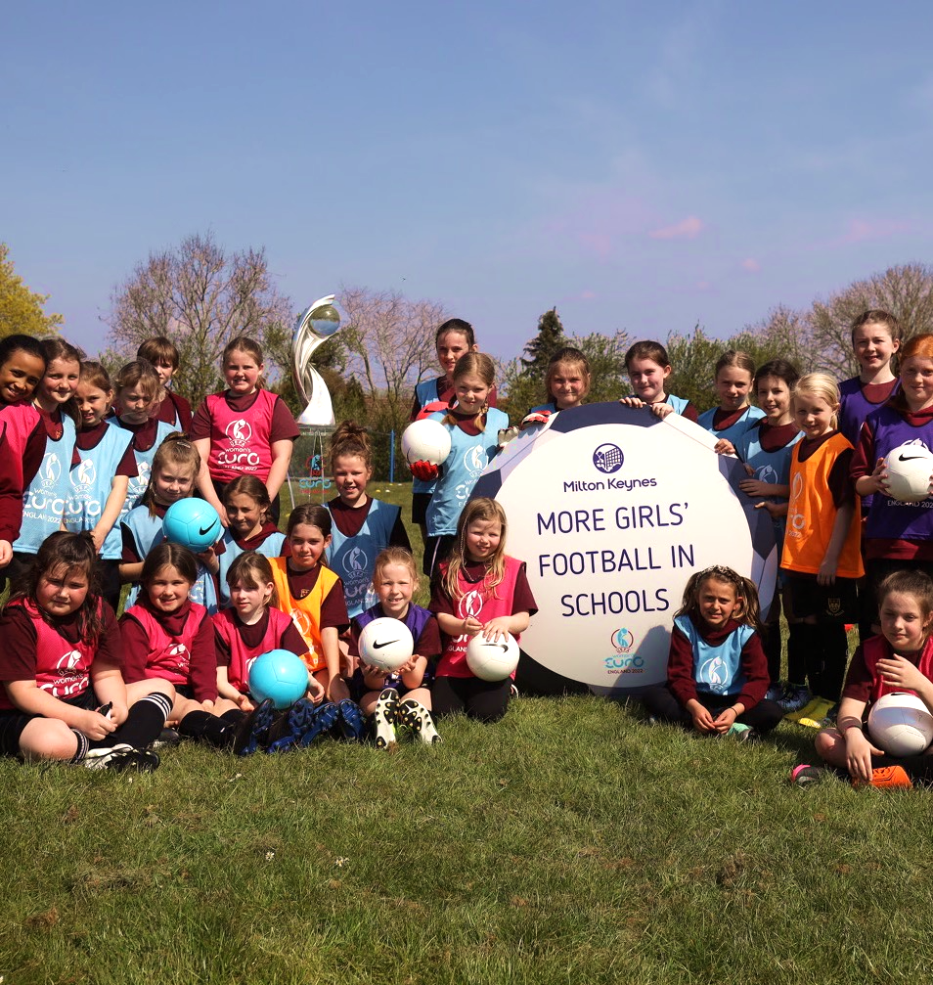
Girls’ football take-over
As UEFA Women’s EURO 2022 is a women’s football tournament, we want the girls to take over the day.
You could come up with your own ideas or use the ideas below for your take-over challenge:
Run the PE lesson with a focus on football.
Take over the playground with football activities.
Design a football feature in the school newsletter or for your school website.
5
Notes:
Day 1
During this day, the girls could take over the day with a football focus. This will help to bridge the gender gap in football in schools and encourage all to get involved.
Pupils can come up with their own ideas or use the ideas suggested on the slide.
Give some pupils time to plan for this day, either first thing on the day or the day before.
Use the planning worksheet provided for pupils to plan their day (optional). They could plan their day individually or in a group. If planning individually, pupils should share their ideas to decide.
To download these resources, sign or register at WEURO2022Schools.com and don’t forget to share your Schools Week activity using #WEURO2022.

Slide 6
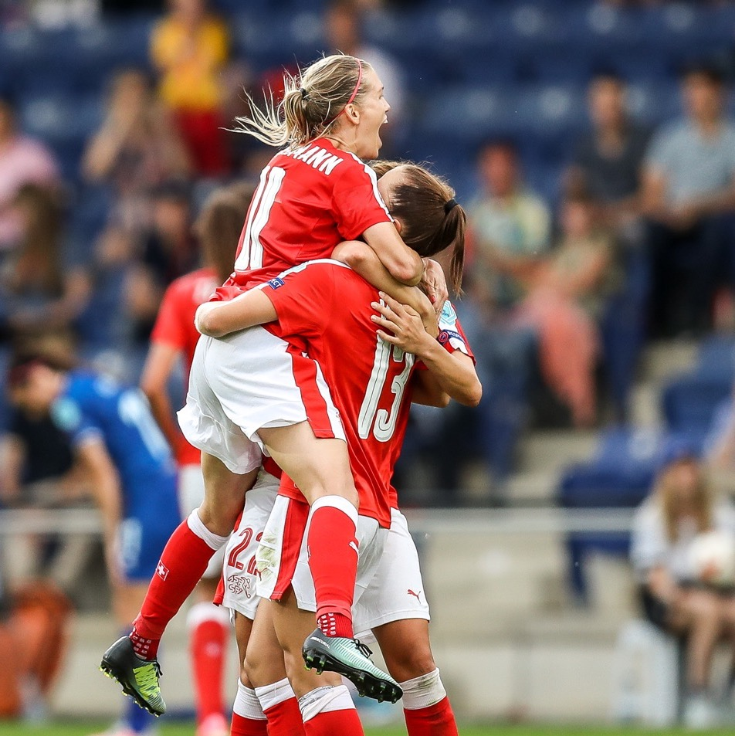
Show your support
We want you to support and celebrate the players, teams and countries competing in the tournament.
Using our Fan zone guide, create your very own Fan zone in your classroom or school.
Try our Adopt a country challenge and spend the day supporting, celebrating and learning about your chosen country.
6
Notes:
Day 2
Use this day to support the players, teams and countries competing in the tournament.
Use our Fan zone guide and printable design templates (flag, bunting, trophy outline) to create a Fan zone in your classroom. Pupils can decorate and bring their Fan zone to life.
Use our Adopt a country challenge worksheet to research a country competing in the tournament and plan how pupils can spend the day celebrating it. You could have a section for this in your Fan zone.
To download these resources, sign or register at WEURO2022Schools.com and don’t forget to share your Schools Week activity using #WEURO2022.

Slide 7
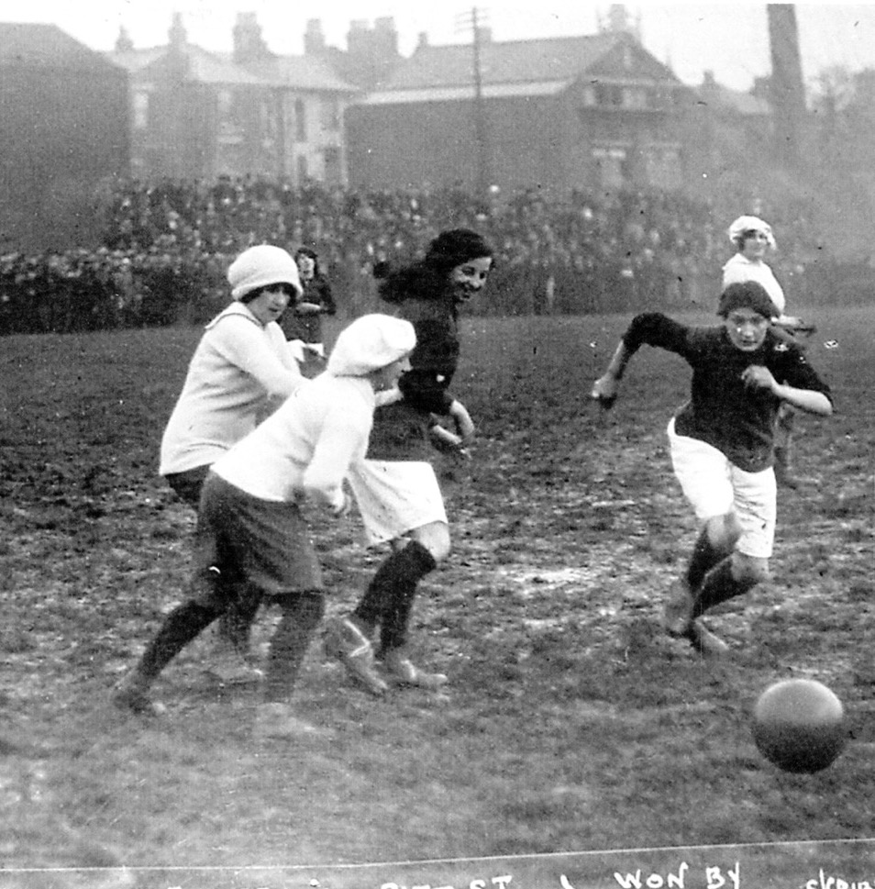
Explore the history
Using our Heritage resources, explore the history of women’s football and create your own exhibition.
The ‘pop up exhibition’ can be a wall, classroom, corridor or hall (or potentially digital) display. It can also be accompanied by a written guide or leaflet.
7
Notes:
Day 3
Use this day to explore the relationship between the development of women’s football, the UEFA Women’s EURO 2022 and wider social change.
Use the KS2 or KS3 resource for this day, depending on the age group you teach. The resource will explain how to create your exhibition.
Image of Portsmouth Ladies - National Football Museum.
To download these resources, sign or register at WEURO2022Schools.com and don’t forget to share your Schools Week activity using #WEURO2022.

Slide 8
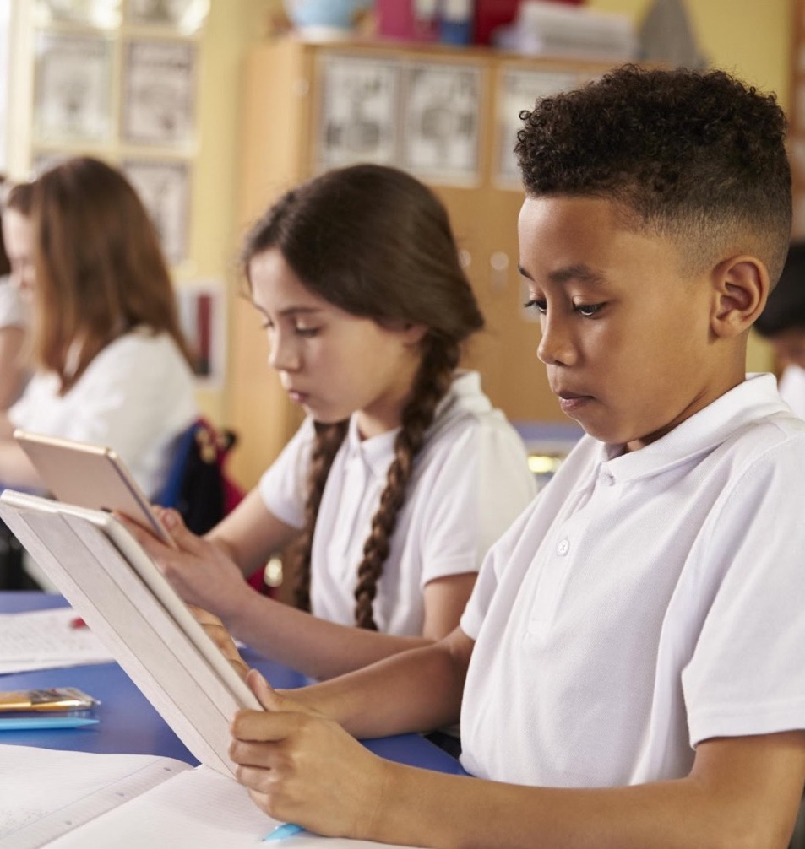

Reading challenge
Take part in our reading challenge using the tournament wall chart to find your favourite book. Place the wall chart in your classroom.
Join some very special online events including a live lesson and reading of a chapter from the new Rocky of the Rovers story!
8
Notes:
Day 4
The National Literacy Trust has helped to produce some fun and engaging resources to support you to enjoy the magic of the tournament, while helping your pupils to get the reading bug alongside their football fever!
A brand new Rocky of the Rovers story will be released in chapters for you to read with your pupils. The first instalment will be published at WEURO2022Schools.com and all other chapters will be published by 07:00, Wednesday and Friday morning, from the 6th of July.
Chapters will be supported by a worksheet, allowing pupils to examine the text further and employ their literacy skills in a fun and engaging way.
More information on the live events can be found in the Teacher Guide.
To download these resources, sign or register at WEURO2022Schools.com and don’t forget to share your Schools Week activity using #WEURO2022.

Slide 9
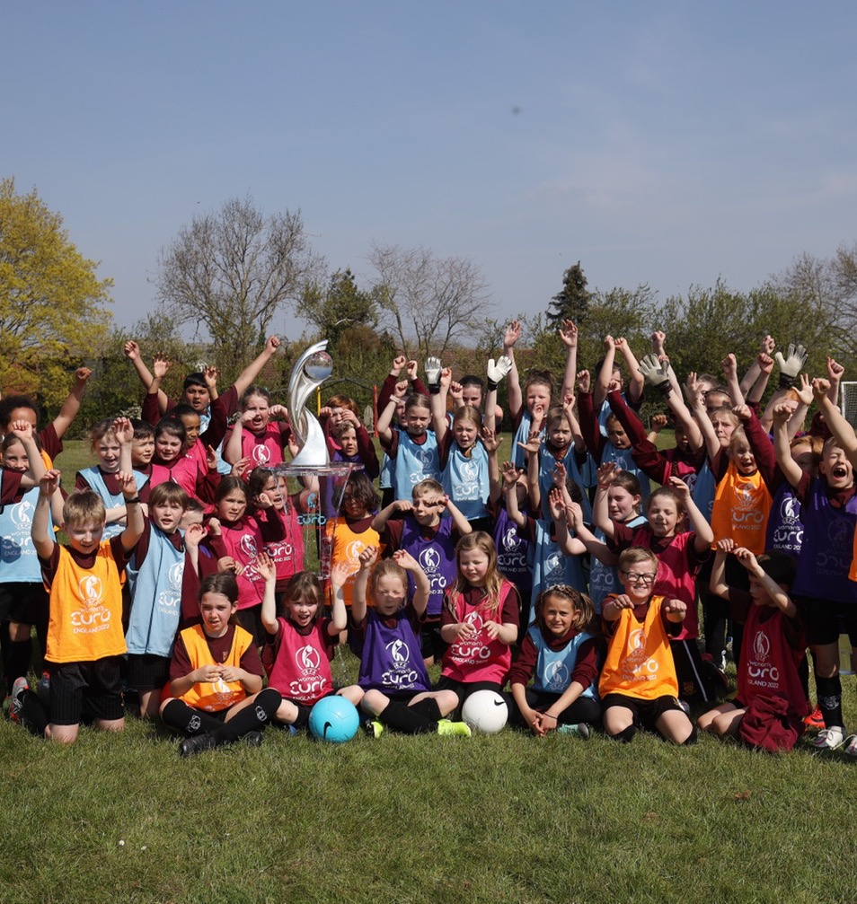
UEFA Women's EURO 2022 themed football festival
Use the Football festival guide to run your own football festival.
A football festival is a fun way to get excited about football and the tournament.
9
Notes:
Day 5
The football festival guide contains a simple overview of the equipment you will need, the roles of the players, how to play different festival formats, adaptations you can make, and useful diagrams to make it easy to understand.
Ask pupils to wear their PE clothing and either use a school hall or playground for this activity.
The guide contains support for KS2 and KS3 football festivals, as well as providing support for pupils with SEN/D.
To download these resources, sign or register at WEURO2022Schools.com

Slide 10
Schools Week overview
Monday 11th July
Tuesday 12th July
Wednesday 13th July
Thursday 14th July
Friday 15th July
Girls’ football take-over (use worksheets provided).
Create a Fan zone (use Fan zone guide).
Adopt a country challenge (use worksheet provided).
Explore the history of women’s football and create an exhibition (use Heritage resources).
Reading challenge (use National Literacy Trust resources).
Run a football festival (use Football festival guide).
10
Notes:
Schools Week overview
Use this Schools Week overview to follow your week.
You can edit the PowerPoint to fit with your Schools Week plan.
You can also download the optional Schools Week timetable to help plan your week and to share with the pupils what the week will look like.
To download these resources, sign or register at WEURO2022Schools.com and don’t forget to share your Schools Week activity using #WEURO2022.

Slide 11
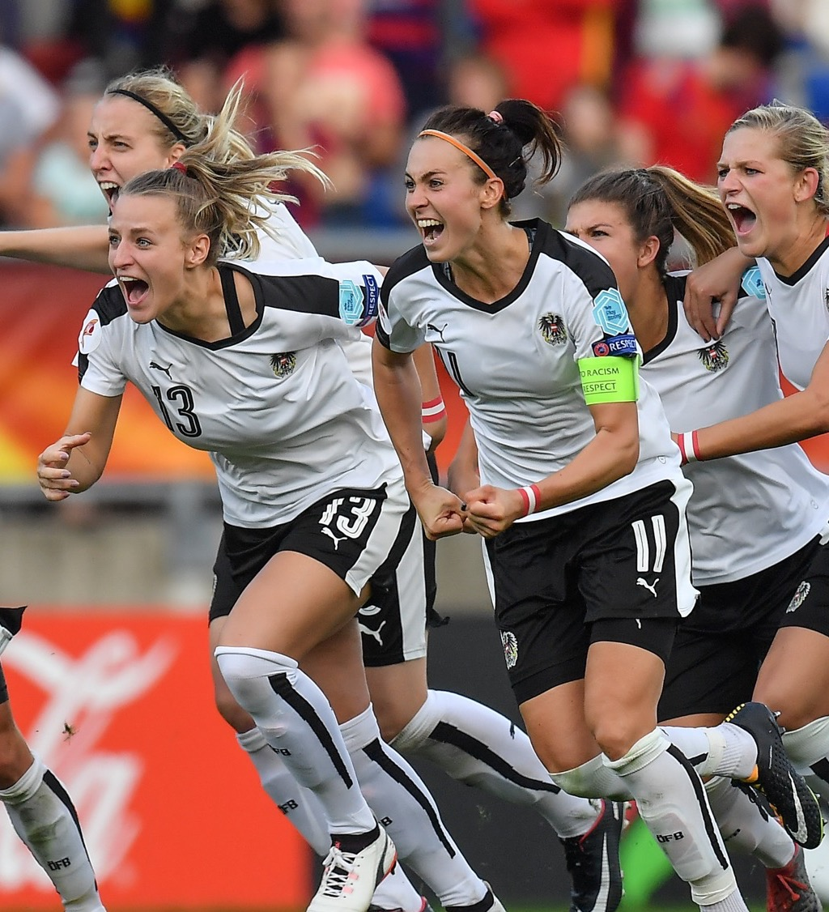
How can you get involved?
Let’s join together as a class, school and country to welcome the finest teams and fans from across Europe to England.
Schools Week will run from 11-15th July.
Share your Schools Week activity using #WEURO2022.
11
Notes:
Getting involved
Read through the information on the screen to get pupils excited about Schools Week.
To download these resources, sign or register at WEURO2022Schools.com and don’t forget to share your Schools Week activity using #WEURO2022.

